Slide 1
Using MOOCs for development of transversal skills
dr. Marko Divjak
Ljubljana, 20. 9. 2017

Slide 2
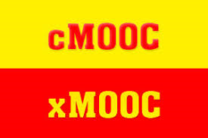
Background
Low completion rates
Online learning approach:
clear structure,
defined objectives and learning outcomes,
interaction / collaboration (co-creation),
virtual sessions (webinars),
extensive feedback,
…
Take some and try to integrate them into the MOOC framework?

Slide 3
DESTINY
Delivering Employability Skills through Innovative Education using MOOCs for Youth → to enhance competitiveness
Managers: TRANSVERSAL SKILLS insufficiently developed
General/soft skills that can be used in a wide variety of situations and work settings.
Highest mismatch between importance and satisfaction + interest of DOBA Business School
TEAMWORK

Slide 4
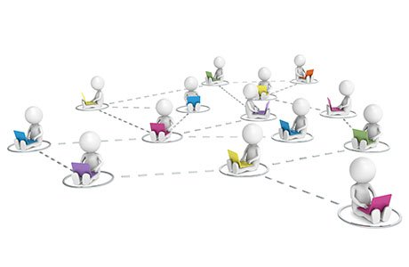
Innovative approach
Interaction + experiential learning
MOOC Study Clubs (MSCs):
Interactive virtual sessions for practicing teamwork skills
H: MSCs enhance development of transversal (teamwork) skills & contribute to higher completion rate

Slide 5
MOOC design and development
Pilot implementation
Follow up implementation
Slovene language
Broader target audience
Intensified promotion and communication to attract participants
Reduced complexity and number of assignments
Intensity levels of participation + certificates
Upgrade and integration of MSCs
KEY ADJUSTMENTS

Slide 6
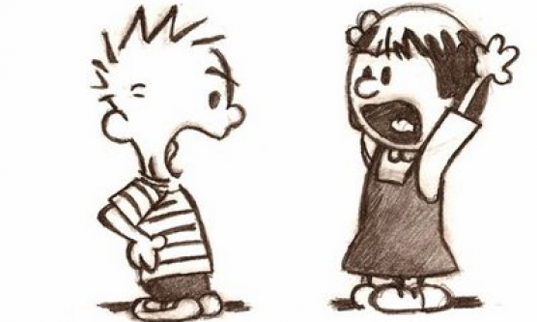
MOOC Study Clubs
TEAM PROCESSES (DYNAMICS)
Technical support
Summary of key topics
Introducing team assignment + division in virtual teams
TEAM ROLES
Working on a team assignment
Ice breaker
Team challenge
Reflection, discussion
SOLVING CONFLICTS
Concluding discussion + feedback

Slide 7
Evaluation method
Completion rate
Pilot: 3/61 → 4.9 %
Follow up: 37/145 → 25.5 %
End of course survey
46/145 → 31.7 %

Slide 8
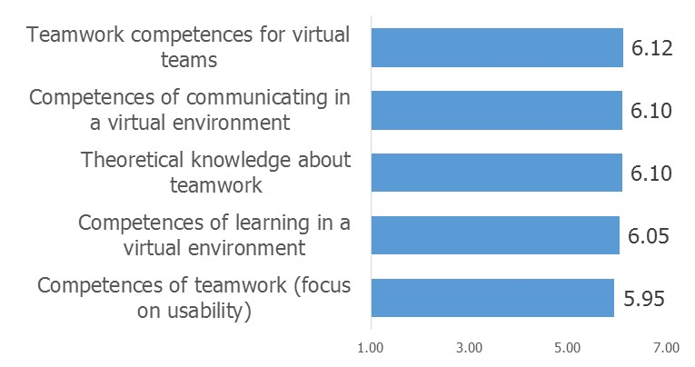
Evaluation of the MOOC
Overall implementation: M = 6.23
The practicality of the course contents: M = 6.23
The complexity of the MOOC: M = 6.10
The complexity of provided activities: M = 6.14
97,7 % of respondents would recommend the course
GENERAL INDICATORS
KNOWLEDGE & COMPETENCES

Slide 9
Evaluation of MSCs
The benefits of MSCs: M = 6.45
The objective almost fully achieved: M = 6.17
Considered as the most useful tool
All aspects of MSCs (e.g. guidance of teachers, team assignments, reflection and discussion) were assessed as highly important for development of teamwork competences
GENERAL INDICATORS
What contributed most to development of teamwork competences?
Combination of MOOC and MSCs (73.9 %)

Slide 10
Conclusions
High satisfaction with the MOOC and MSCs + reported benefits of MSCs in developing teamwork competences
MSCs + other adjustments (e.g. native language) => higher completion rate!
Small markets: more opportunities to add interactive components into MOOC framework
Further research for more precise estimates of contributions of different components (other measures of competence development?)

Slide 11
Any questions or comments?
marko.divjak@doba.si

